Slide 1
Drive Value; Minimise Risks
Rob Moore
Principal Consultant
rob.moore@readify.net

Slide 2
Why am I talking to you?
Raise your hand if you’ve ever stopped a major project part-way because it was clear it wouldn’t be successful?
Agile Manifesto is 15 years old!
It’s hard to deliver quick value and minimise risk
We don’t base decisions on information
We hardly ever change plans
We never know if we’ve succeeded
Notes:
Agile Manifesto is 15 years old and we still talk about introducing Agile to organisations!
I constantly talk to organisations that have trouble delivering value within 2 or 3 months (or less!) and consequently deal with a lot of risk around deploying and developing software.
I rarely see organisations base decisions on information and learnings rather than gut feel and momentum.
Most organisations I talk to are following plans that were set 6-12 months in advance and rarely vary from those plans, even when faced with learnings that invalidate the original plan.
And most importantly, it’s rare to see a project measure if it was successful against it’s goals after deployment, let alone while delivering.

Slide 3

FOCUS
BUSINESS AGILITY and INNOVATION
Notes:
More and more techniques are emerging, and becoming commonplace, that remove technical hurdles to and empower more agility in how software is specified and designed by product owners, and this is allowing companies to place a great focus on innovation.
It’s becoming something that gets discussed increasingly at C-level as business naturally take more of an interest in trying to respond to their customer’s needs faster etc.

Slide 4
Why innovate?
Reduce costs
Increase efficiency
Increase market share
Improve customer engagement
Leverage a competitive advantage
Notes:
Honing in specifically on innovation there are a range of good reasons why we might want to innovate.
I’m sure that all of you have come across projects in your organisations that try to achieve one or more of these goals.

Slide 5
“reduc[ing] the cost, time, and risk of delivering incremental changes to users”
Continuous Delivery
Jez Humble
Principal Consultant, ThoughtWorks
Notes:
One of the more important techniques to come to light in recent years that helps improve business agility is Continuous Delivery.
According to Jez Humble, who coined that term and wrote a book on the subject, continuous delivery is “reduc[ing] the cost, time, and risk of delivering incremental changes to users”.
More specifically it involves ensuring software is constantly in a releasable state on demand and reducing risk by creating confidence and repeatability to take commits that developers push through a consistent, largely automated deployment pipeline to eventually get to production.

Slide 6
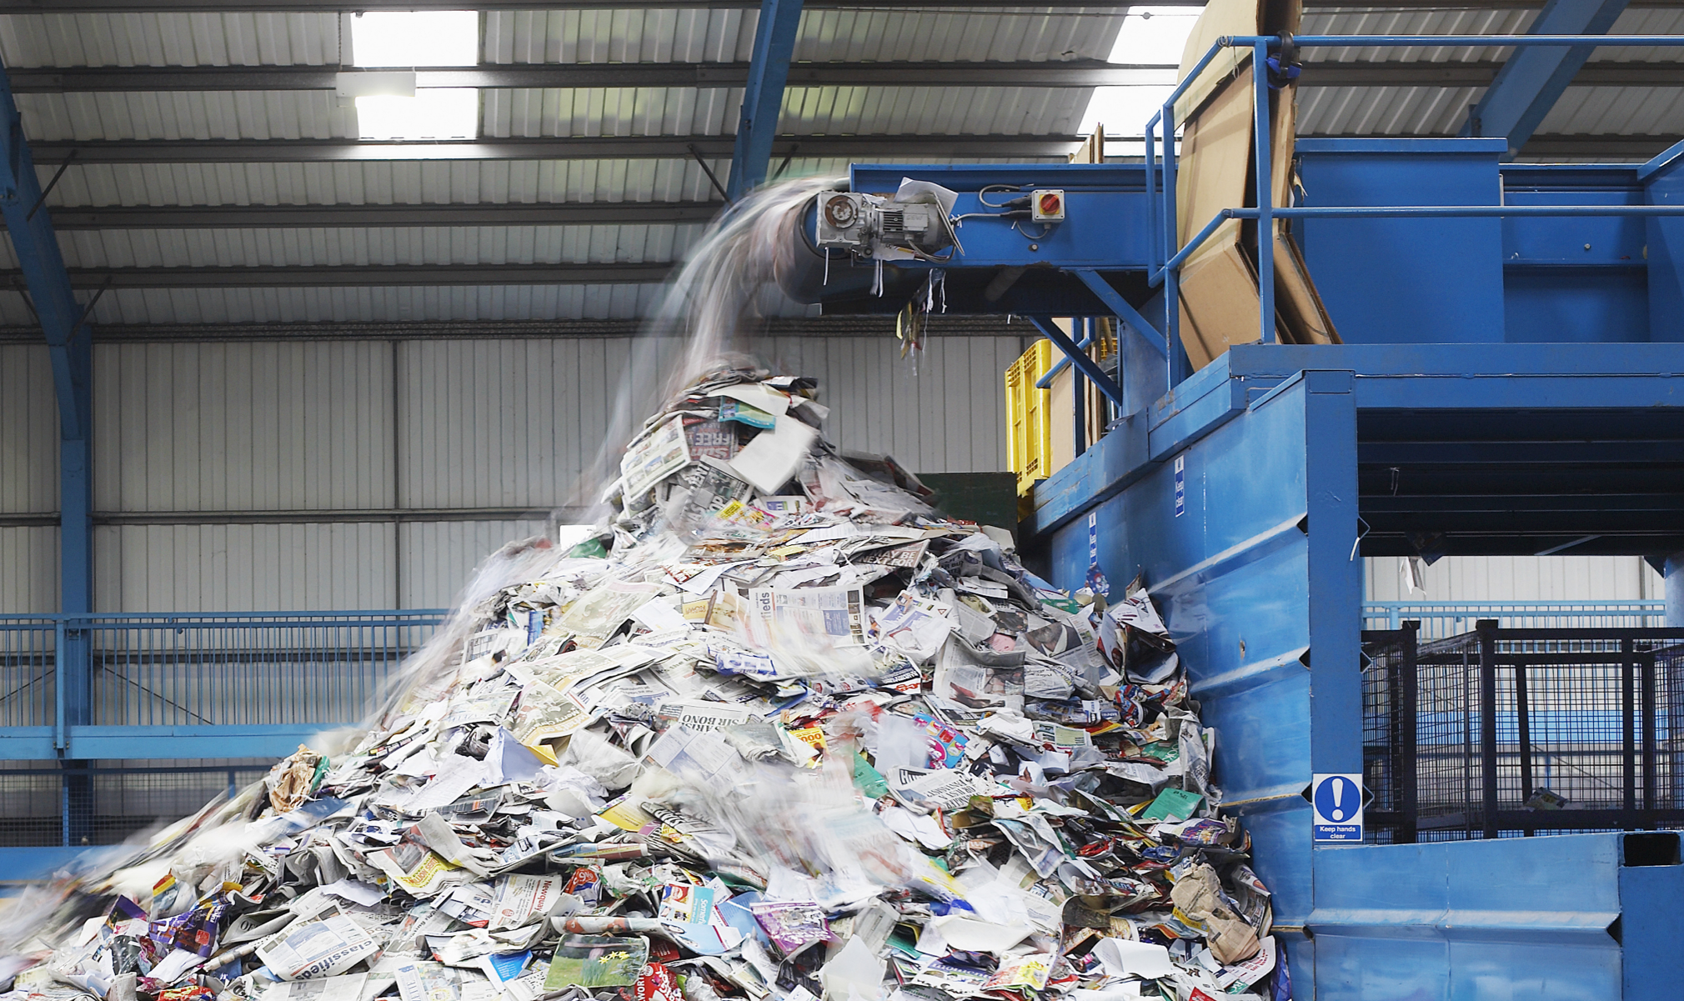
Notes:
Development teams are getting better and better at developing and delivering software.
But... Biggest form of waste is delivering the wrong thing....
Put another way, we are getting more and more efficient at delivering waste – like this waste processing machine you see on the screen.
The thing about this waste is it’s so much more than what you first think about:
Wasted time building something that will not realize expected value
Opportunity cost - time we could have spent delivering a better product
Operational cost - deployment, maintenance, unnecessary code etc.
Continuous Delivery helps with this to an extent, but that’s still largely localized to the original solution being worked on.

Slide 7
Time and time again…
Waste and inefficiency
Overblown scopes
Big bang deployments
Long funding cycles
Lack of measurement
Lack of realisation of outcomes
Notes:
It’s not just wate and inefficiency that’s the problem though.
Time and time again we see the same problems.

Slide 8
Why do we see these problems?
Planning
Development
Release/Post Release
Waterfall
High Performing Agile Team
Waterfall
Notes:
Making an assumption that we have high-performing teams using Continuous Delivery, then the problem is largely what happens before and after that team does their great work.
What we so often see is traditional, waterfall processes that book-end development work.
The initial planning cycle will involve defining and scheduling large projects with large budgets and expectations are set as if everything is known up front about the needs and outcomes of the project.
And then after the development team has done their awesome work it gets even worse as organisations are often reluctant to QA and release until the project is nearing completion – again to fit in with the original plan. The project is often considered complete when the plan ends which is often at the point the software is handed over to the operations and support team to deploy and maintain. Then there is the fact that it often takes a long time before we understand the benefits realisation of developed software because we aren’t actively trying to measure it.

Slide 9
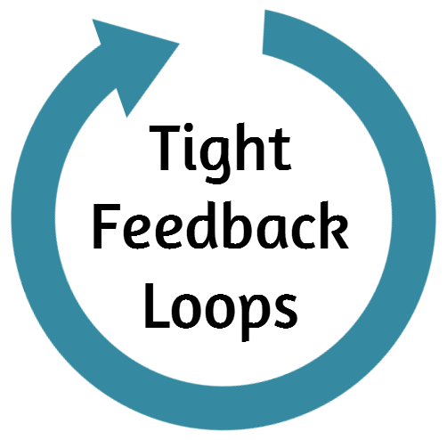
TECHNICAL
Test Automation
Continuous Integration
Technical Metrics
BUSINESS
A/B Testing
Continuous Delivery
Usage Analytics
STRATEGIC
?
?
Org Goals!
Notes:
Our high performing agile teams, using continuous delivery give us both technical and business agility.
This is largely driven by tight feedback loops – on a technical level we use technical metrics to constantly improve and measure performance and from a business point of view we use usage analytics to constantly improve and measure customer satisfaction.
But what about our strategic agility?
[transition]
How can we made sure that our projects align to organizational goals? How can we reduce the cost and risk associated with innovation?

Slide 10
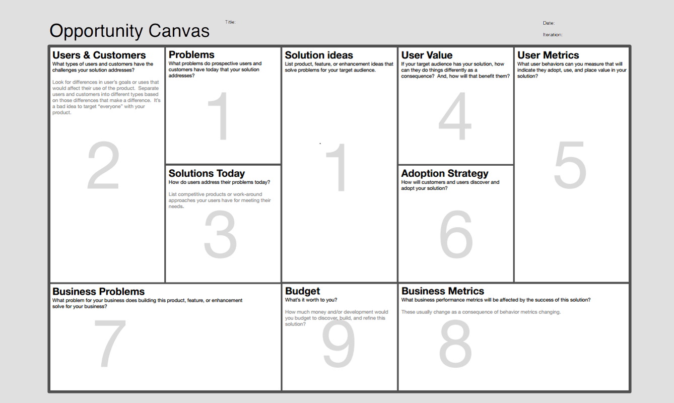
Notes:
This is a quick/easy way to start trying to align work to organizational goals.
People go into solution mode too early
Start with problem: opens door to more innovative / more efficient / less risky / RoI aligned projects
Practical tip: start all projects with op canvas / business model canvas / lean canvas
Challenge existing opinions, start with metrics, shared understanding, challenging conversations

Slide 11
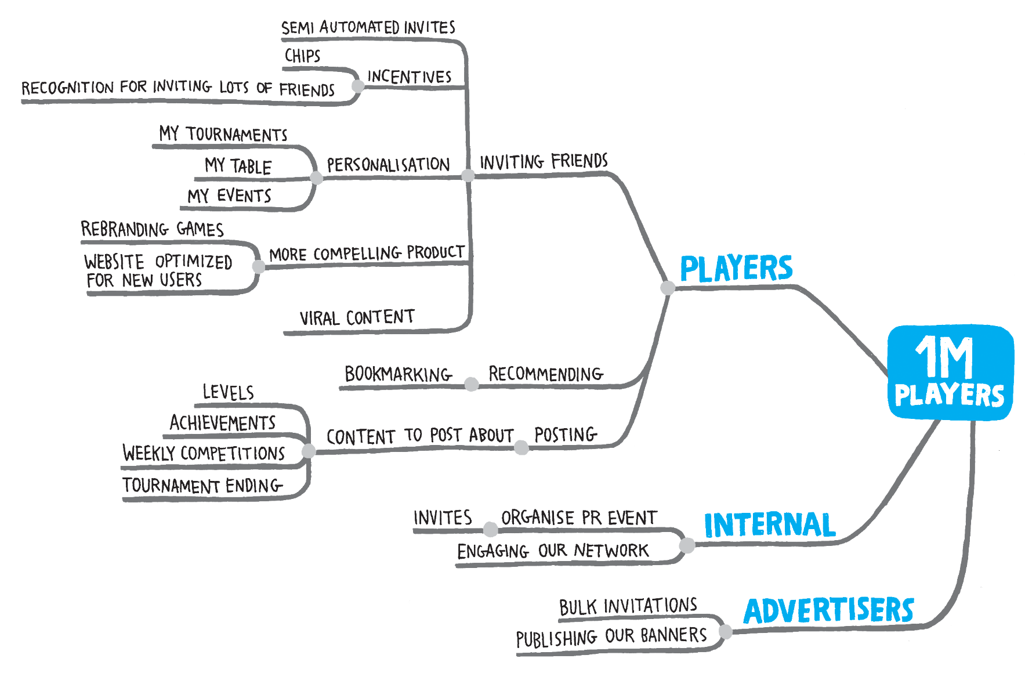
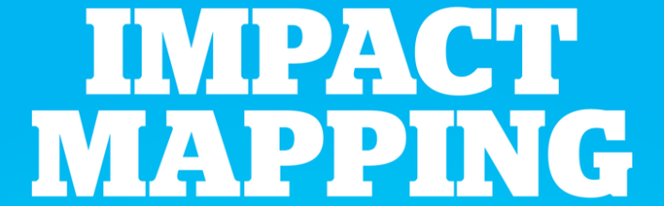
“It might sound like common sense to know this upfront, but from my experience very few people working on delivery know the actual expected business objectives”
Gojko Adzic
www.impactmapping.org
Notes:
Projects often start with a feature or solution in mind. A feature list or backlog is created and development begins.
Impact mapping is a collaboration and product discovery tool that encourages people to focus on achieving goals rather than delivering software. It is a useful strategic technique that clearly frames our objectives and helps identify ideas and assumptions that we may otherwise not recognise.
Impact mapping use useful for identifying alternatives that may be cheaper and less risky. It is useful in identifying experiments/MVPs that we can use to test our assumptions and see whether these are having the effect that we assumed they would.

Slide 12
TECHNICAL
Test Automation
Continuous Integration
Technical Metrics
BUSINESS
A/B Testing
Continuous Delivery
Usage Analytics
STRATEGIC
?
?
Org Goals!
Notes:
There is a problem with this model though…
I’m curious if anyone can guess what the problem I have with this is?

Slide 13
STRATEGIC
?
?
Org Goals!
BUSINESS
A/B Testing
Continuous Delivery
Usage Analytics
TECHNICAL
Test Automation
Continuous Integration
Technical Metrics
Notes:
In reality, we should be driving what happens on the ground from the board and executive via our organizational goals, strategic direction and company culture.
But, how can we do this? Particularly when, as we’ve already discussed, the traditional way we run projects is fundamentally flawed.

Slide 14
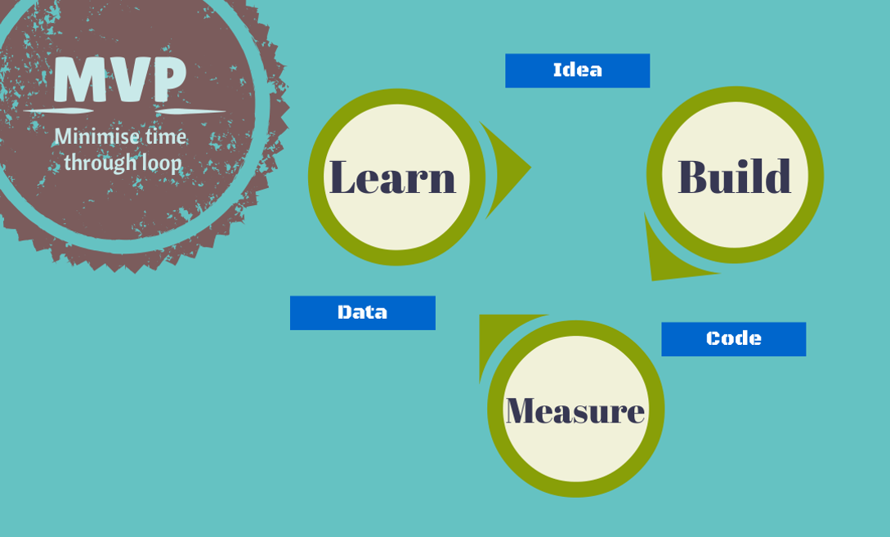
Notes:
This is where MVPs come in.
Lean Startup popularised MVPs and introduced the concept of the Build, Measure, Learn loop. Basically this means that we start with an idea, build something small to explore that idea, measure what happens when that idea is deployed and extract a learning from those measurements. We then use that learning to decide what to do next. We go through this loop again and again and again.
Put simply, according to Eric Ries who wrote Lean Startup an MVP is: “That version of a new product which allows a team to collect the maximum amount of validated learning about customers with the least effort.”
Lean Startup also introduces the concept of a minimum viable product as that version of a product which allows a team to collect the maximum amount of validated learning with the least amount of effort.
Examples:
Consider exposing your MVP to early adopters but be careful that these adopters are real customers. Be aware that of the biases that early adopters often have.
Consider smoke tests such as click throughs to “Register your interest” pages, but don’t go too far - please consider your customer they are not guinea pigs that will put themselves out to confirm your MVP.
Consider concierge services – build a human system to prove an idea in the small scale, and then look at using technology to scale. This approach is often overlooked by established organisations but ironically is the mechanism by which many companies were seeded.

Slide 15
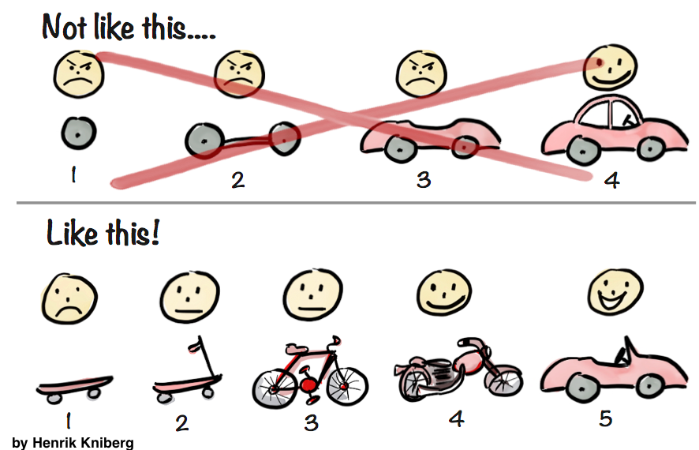
What MVPs are and aren’t
Notes:
It’s easier to describe what MVPs are with diagrams rather than words.
http://blog.deming.org/2014/11/minimal-viable-product/

Slide 16
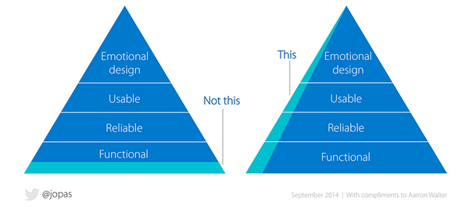
What MVPs are and aren’t
Notes:
https://twitter.com/berndschiffer/status/550169576299044864

Slide 17
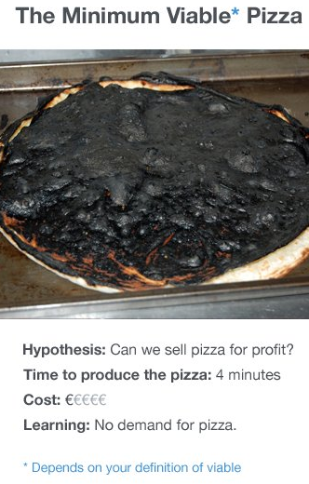
What MVPs are and aren’t
Notes:
https://twitter.com/noluckmurphy/status/700695023428325376

Slide 18
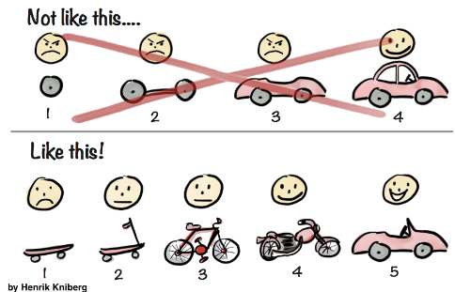

What MVPs are and aren’t
“If you are not embarrassed by the first version of your product, you’ve launched too late.”
Reid Hoffman
Notes:
http://startupquote.com/post/855482768
This might involve hours or days of effort or it might be days or weeks of effort – it depends entirely on what you are building, what hypothesis you are trying to test and the customers you are targeting.

Slide 19
MVPs are becoming easier
Open Source maturity
Tooling maturity
and…
Notes:
OSS: stand on the shoulders of giants
Tooling: to support rapid development and deployment

Slide 20

IaaS
Cloud computing
PaaS
Notes:
One of the biggest traditional blockers to innovation is the long-wait times for IT departments to provide computing. I’ve been in organisations where it takes months to get a VM.
Cloud computing has completely changed that, firstly by comoditising VMs so it takes seconds rather than days/weeks/months, but more importantly PaaS completely changed to ballgame by enabling faster development with less operational overhead!
If you kill a project you can easily remove the infrastructure.

Slide 21
MVP Maturity
Used for one-off projects:
To reduce cost and risk
To reduce time to market
To drive innovation
For pure innovation
Consistent adoption across range of projects
MVPs over projects
Notes:
The usual maturity model we see for use of MVPs in organisations starts with one-off projects where there is a clear and present need for the advantages it provides such as reduced cost or risk or faster time to market.
Sidenote: Pure innovation is a really interesting application of MVPs – the sort of R&D that involves pure experimentation is a very scientific process that aligns well to the MVP approach, but interestingly it deliberately doesn’t align well to following organisation goals because they enforce an arbitrary constraint. As organisations see the benefit of the thinking and application of MVPs there is a tendency to start using the approach more consistently across all projects or a particular subset such as innovation-focussed projects. I see the end-goal of MVPs to be a MVPs over projects mentality.

Slide 22
MVPs over projects
Move from projects to MVPs
All work is a hypothesis until used by real users
“The more we finish, the more we finish”
Stable, performing teams
Small budgets, less upfront planning, fast releases
Agile PMO; unit of measure: validated learning
Watch: “How Kanban Helps Us Move Beyond Traditional PMO” by David Joyce
Notes:
MVPs over projects is where MVPs can really drive strategic agility. This comes down to a realization that the concept of projects for software development is actually insidious.
MVPs over projects starts from the viewpoint that all work is a hypothesis until used by real users.
It helps dispel the two main problems with projects:
The mentalility of “the more we start, the more we finish”, which we know is wrong from the learnings about minimizing work in progress via Lean
The cost associated with loss of high performance when we disband teams when a project ends
By having small budgets, less upfront planning (since there is less risk) and fast releases we can directly counter the waterfall bookend of our high performing Agile teams.
This naturally leads to the concept of an Agile PMO, whose unit of measure is amount of validated learning rather than number of projects in the portfolio. David Joyce has a highly recommendable talk that explores this further called “How Kanban Helps Us Move Beyond Traditional PMO”.

Slide 23
Recommendations
Build org culture of continuous improvement
Embrace simplicity and break down complexity
Business value / drive over technology
All decisions based on information / learnings
Notes:
Our usual recommendations when we work with customers on this cultural change usually amount to these four things at a high level.

Slide 24
“Challenge yourself to start simple then inspect and adapt”
Notes:
So how do you start? I can be overwhelming to think about changing the culture of a company to move towards an Agile PMO.
I always use this motto as a way to break down complexity, start as simple as possible and then use an inspect and adapt learning cycle to get to where I’m headed.

Slide 25
Simple idea to start the journey…
Toyota Australia CIO asked, for all projects:
Project Name
Value provided
Aligned to (written down) strategic initiative
Within a year 20% -> 58%
Change behaviour through measurement
Notes:
This is a great way to start simple.

Slide 26
Another idea…
Create an innovation fund
Require business goals thinking
Stable high-performing team(s)
Focus on early value and minimizing risk
Kill if value isn’t measurably demonstrated
Notes:
Business goals thinking: not a req spec e.g. opportunity canvas – should take days not months.
This should be easy to achieve for most C-levels e.g. using discretionary spend.

Slide 27
2-speed “project” economy…
Use the run – grow – transform model
Start with transform and use an MVP approach
Will naturally grow over time with successes
Toyota Australia do this
Eventually you can move towards an Agile PMO

Slide 28
What’s the end goal?
1. Idea / Experiment
Pivot | Continue | Stop
4. Learn
One
MVP
2 .Build
3. Measure
Based on work from Eric Reis, David Joyce
Notes:
Just as discussed earlier in the presentation – the strategic techniques we’ve covered also help to reduce feedback loops.
This acknowledges that risk starts where knowledge ends, so to minimise risk and potential waste organisations should use learning and knowledge to justify all decisions at every level of the business – technical, business and strategic.

Slide 29
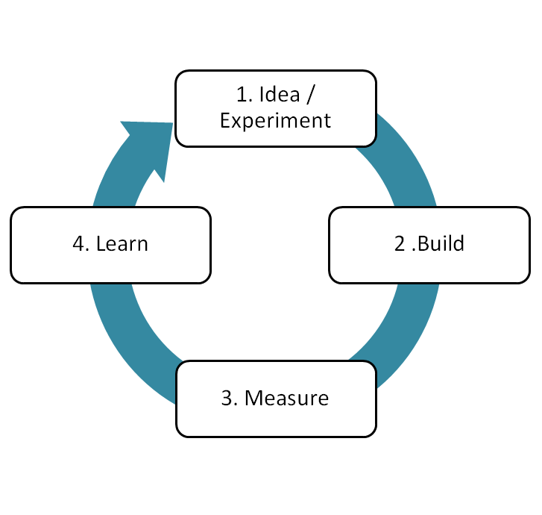
Learning-based culture
STRATEGIC
Opportunity Canvas
MVPs instead of projects
Org Goals!
BUSINESS
A/B Testing
Continuous Delivery
Usage Analytics
TECHNICAL
Test Automation
Continuous Integration
Technical Metrics
Notes:
We think that the term “learning based culture” nicely sums up this notion and logically includes the fact that the technical and business agility that a business has empowers the business to drive all learning and decisions from a strategic level.
There is a particularly good talk about using validated learning to drive strategic goals by David Joyce in his talk about the Agile PMO, which we highly encourage you to watch as further research.

Slide 30

Silver bullet!?
Notes:
https://www.flickr.com/photos/eschipul/4160817135
MVPs aren’t a silver bullet.

Slide 31
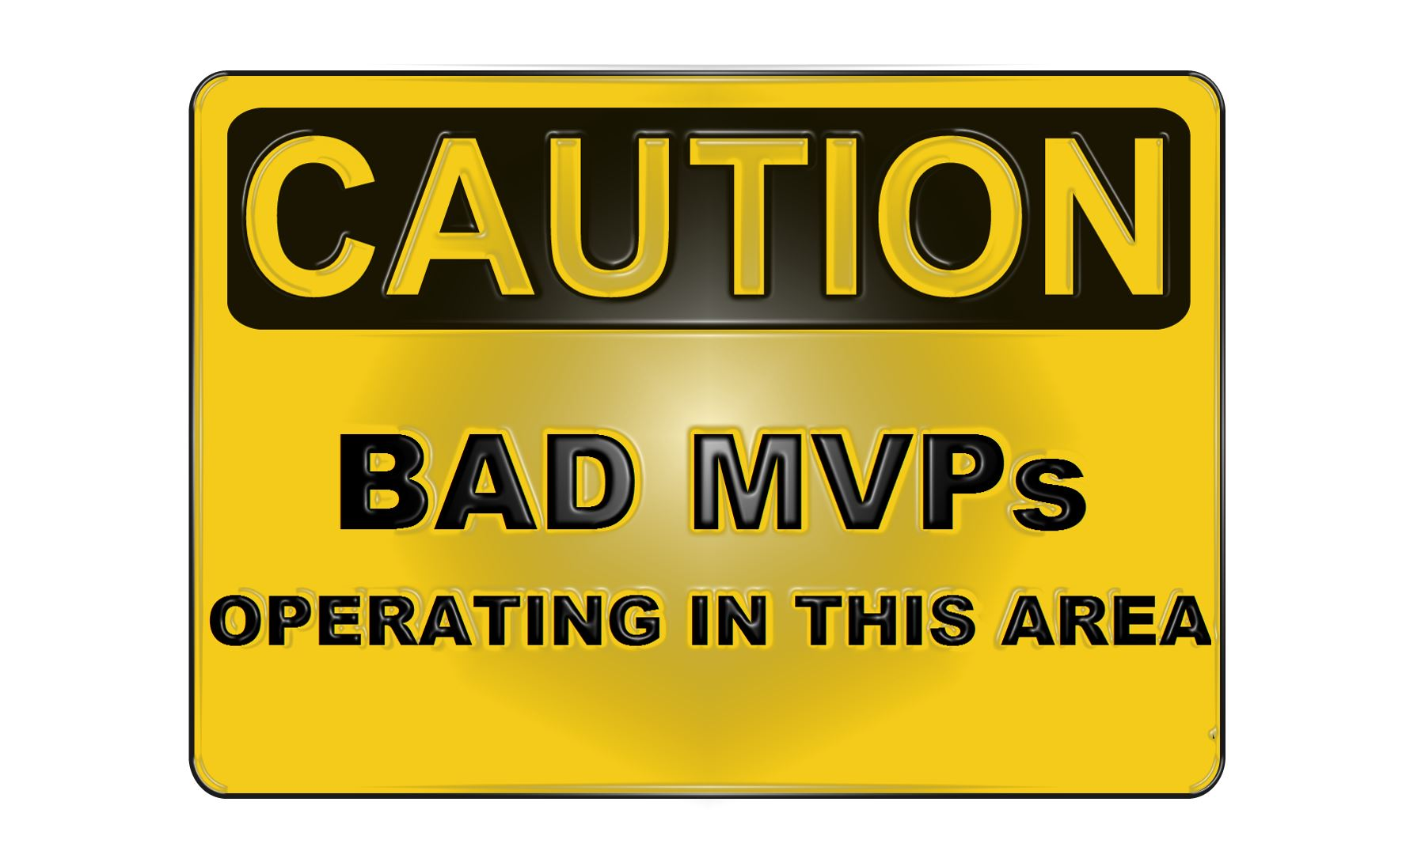
Notes:
Vanity Metrics
Minimal Marketable product != MVP
Fear of releasing to REAL customers
Bad MVPs
Internal Releases – Releasing to internal users when those users are not your target customers.
Large MVPs – MVPs that contain pet feature or unnecessary features. Consider each feature being an MBP
Vanity Metrics – Only looking at metrics that confirm your hypothesis, Gross metrics e.g. Gross Profit are usually bad examples of metrics as they can be influenced in many ways and can hide the real performance of your MVP
“But.. MVP = Crap half baked product”
Sure when done badly. There is no magic solution other than to try and collected VALIDATED LEARNING so you need to get creative.

Slide 32

Cultural Change
Notes:
What we are talking about here is absolutely cultural change – it’s a completely different way of thinking about management and planning.
We’ve reached the conclusion through experience and some reasoning that in order to pull this off you need to involve executive management at the top of the chain for two reasons:
To change the culture of an entire company you clearly need to drive that with help from executives
In order to drive all decisions and actions in a company from the strategic goals you need the people who set the strategic goals to cooperate
If this "movement" was to start with only one person we believe it has to be someone at the top of the food chain.
Reiterate: It's not easy and it does take years.

Slide 33
Unscientific behaviours
Tenacity
AUTHORITY
CONFORMITY
Notes:
Something interesting to consider as part of that cultural change is to look at behaviours that we traditionally reinforce that are actually counter-productive in an environment where you are moving to information-based decisions and scientific thinking.
These unscientific behaviours that now have to be discouraged include:
Tenacity – people absorbed in their own belief not willing to accept or adapt when presented with contrary information
Authority – We are told what to believe even if deep down we don't believe it.
Conformity – Because everyone else is doing it - fashionable.

Slide 34
If you don’t; someone else will
Deliver on Strategic Goals
Deliver the RIGHT Things
Rapid Innovation
Competitive Advantage
Minimise Waste
Notes:
Once an organisation embraces a learning-based culture it can more easily [Transition] deliver on strategic goals and [Transition] deliver the right things.
[Transition]
If your whole organisation is Agile then you have the unique opportunity of being able to identify new markets and opportunities to rapidly innovate and react immediately with quick experiments to validate whether it’s worth investing more resources in that area.
By the time your competitors realise you’ve either already pulled out and are looking at the next opportunity because there is nothing to be gained or you’ve already cornered the market.
Traditionally organisations have focused on delivering one or two ideas, by reducing feedback cycles we can quickly prove or disprove many more ideas, the result being that we are more likely to find the killer feature or product. Now, that is rapid innovation.
[Transition]
All of this adds up to an organisation being able to ensure it has a competitive advantage.
[Transition]
Another great thing is that by only basing decision on validated learning you will minimise waste by not spending resources on activities that don’t deliver on strategic goals.

Slide 35
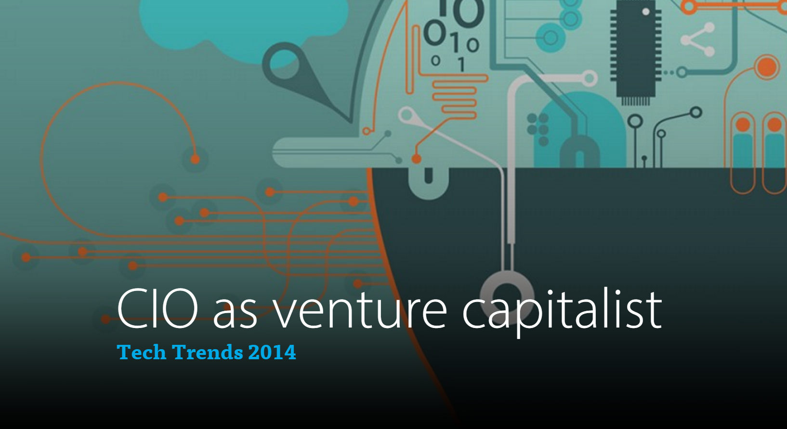
Notes:
http://dupress.com/articles/2014-tech-trends-cio-venture-capitalist/
Before I finish up I wanted to leave you with an interesting thought to consider.
A couple of years ago Deloitte published their tech trends for 2014, the first item was entitled "CIO as a venture capitalist"
"CIOs who want to help drive business growth and innovation will likely need to develop a new mindset and new capabilities. Like venture capitalists, CIOs should actively manage their IT portfolio in a way that drives enterprise value and evaluate portfolio performance in terms that business leaders understand— value, risk, and time horizon to reward. CIOs who can combine this with agility and align the desired talent can reshape how they run the business of IT."
This shows how the industry is recognizing the need to look at strategic agile thinking. I also describes the idea that CIOs and decision makes should start to think about investments rather than projects. e.g. rather than start a $100K project, think about investing $100K, what will provide the best returns? How can I balance risk?

Slide 36
Questions?
Rob Moore
Principal Consultant
rob.moore@readify.net

